Slide 1
UPPER SIXTH ARTS
GEOGRAPHY
Lesson 8
The Urban Fringe
Notes:
Good morning, class, and welcome to our geography lesson. I am your geography teacher, Mr Kamdem. Today we are starting Lesson 8: The Urban Fringe.

Slide 2
CLASS INFO
Class, Chapter and Duration
Class | Upper Sixth Arts
Chapter | Module 5: Understanding and managing settlement dynamics across the world in general and Cameroon in particular
Duration | 2 periods (2 × 50 minutes)
Notes:
This lesson is for Upper Sixth Arts. It belongs to Module 5: Understanding and managing settlement dynamics across the world in general and Cameroon in particular. We shall need 2 periods to cover it.

Slide 3
IDENTIFICATION
Lesson Identification
Topic | Rural Settlement
Sub-topic | Recent Changes in Rural Settlements
Lesson | Lesson 8: The Urban Fringe
Notions / Concepts | Rural-urban fringe, urban sprawl, land use conflict, peri-urban agriculture.
Syllabus focus | Meaning, characteristics and challenges of urban fringes.
Competence | Learners are able to describe the urban fringe and explain its challenges.
Notes:
Our topic is Rural Settlement, and the sub-topic is Recent Changes in Rural Settlements. The key notions we shall use today are: rural-urban fringe, urban sprawl, land use conflict, peri-urban agriculture. At the end, you should be able to do this: learners are able to describe the urban fringe and explain its challenges.

Slide 4

HOMEWORK CORRECTION
Correction of the Homework
Question (Lesson 7: Changes in Rural Settlements):
Interview an elder about how your village has changed in 30 years.
Notes:
Before we start the new lesson, let us correct the homework I gave you at the end of Lesson 7: Changes in Rural Settlements. The question was: Interview an elder about how your village has changed in 30 years. Take out your exercise books.

Slide 5
HOMEWORK CORRECTION
Correction: Possible Answer
Example: 30 years ago the village had mud houses, no road and no school; today it has block houses, a road, a primary school and a borehole, but many young people have left for town.
Notes:
Here is a good answer. Example: 30 years ago the village had mud houses, no road and no school; today it has block houses, a road, a primary school and a borehole, but many young people have left for town. Compare it with your own answer and correct your work in red.

Slide 6
LESSON PLAN
Lesson Plan
Correction of the homework
Objectives and recall
Real-life situation and action to take
Learning activities
Board summary
Evaluation, remediation and homework
Notes:
Here is the plan of our lesson today. First, we shall correct the homework. Then we shall look at the objectives and recall what you already know. After that, we shall study a situation from real life and the action to take, and do the learning activities. Finally, we shall copy the board summary, do the evaluation and the remediation, and I will give you the homework.

Slide 7
OBJECTIVES
Objectives
By the end of this lesson, you should be able to:
Define the rural-urban fringe.
Describe its characteristics.
Explain its challenges and solutions.
Notes:
By the end of this lesson, you should be able to do three things. Number 1: define the rural-urban fringe. Number 2: describe its characteristics. Number 3: explain its challenges and solutions.

Slide 8
PREVIOUS KNOWLEDGE
Previous Knowledge
Towns grow outwards.
Villages near towns become commuter villages.
Notes:
Let us first remember what you already know. Towns grow outwards. Villages near towns become commuter villages. Keep this in mind, because we shall build on it today.

Slide 9
REAL-LIFE SITUATION
Situation in Real Life
On the edge of Yaoundé, farms of cassava stand next to new villas, a quarry, a rubbish dump and unfinished roads. Farmers and builders argue about the land.
Notes:
Listen carefully to this situation from real life. On the edge of Yaoundé, farms of cassava stand next to new villas, a quarry, a rubbish dump and unfinished roads. Farmers and builders argue about the land. Think about it, because I am going to ask you some questions.

Slide 10
REAL-LIFE SITUATION
Situation: Question 1
What is the problem in the situation?
Notes:
Question 1: What is the problem in the situation? Think for a moment, then raise your hand to answer.

Slide 11
REAL-LIFE SITUATION
Answer
Town and countryside mix and compete for land.
Notes:
Good. Town and countryside mix and compete for land.

Slide 12
REAL-LIFE SITUATION
Situation: Question 2
What is this zone called?
Notes:
Question 2: What is this zone called? Think for a moment, then raise your hand to answer.

Slide 13
REAL-LIFE SITUATION
Answer
The rural-urban fringe.
Notes:
Good. The rural-urban fringe.

Slide 14
REAL-LIFE SITUATION
Situation: Question 3
Why do people argue about land?
Notes:
Question 3: Why do people argue about land? Think for a moment, then raise your hand to answer.

Slide 15
REAL-LIFE SITUATION
Possible Answer
Farmers and builders want the same land.
Notes:
Good. Farmers and builders want the same land.

Slide 16
ACTION TO TAKE
Action to Take
Manage the urban fringe to protect farmland and control sprawl.
Notes:
From this situation, the action we are working towards in this lesson is the following: manage the urban fringe to protect farmland and control sprawl.

Slide 17
JUSTIFICATION
Justification of the Lesson
This lesson helps us to understand the fast-changing edge of our towns.
Notes:
Why is this lesson important for you? This lesson helps us to understand the fast-changing edge of our towns.

Slide 18
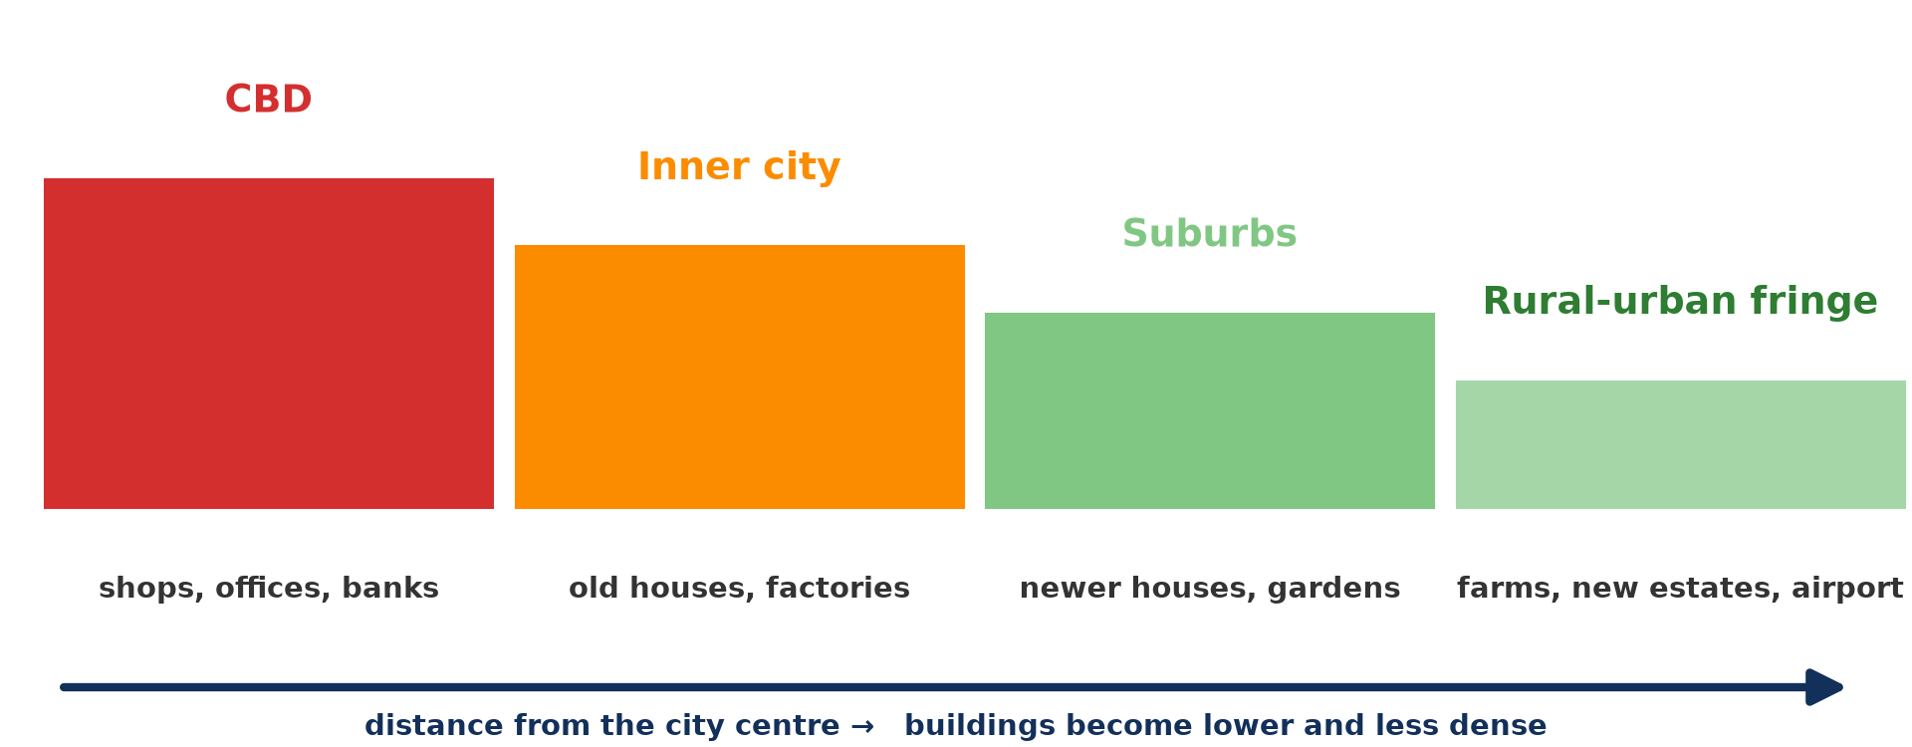
1. MEANING
Activity 1
Zones from the centre to the fringe.
Notes:
Activity 1. Look carefully at this diagram: zones from the centre to the fringe. Observe every detail before I ask the question.

Slide 19
1. MEANING
Activity 1: Question
Where is the rural-urban fringe?
Notes:
Here is the question for Activity 1: Where is the rural-urban fringe? Take one minute to think and write your answer in your rough notebook.

Slide 20
1. MEANING
Activity 1: Answer
At the edge of the town where it meets the countryside.
Notes:
Let us check the answer together. At the edge of the town where it meets the countryside.

Slide 21

2. CHARACTERISTICS
Activity 2
New housing estates on the edge of a city.
Notes:
Activity 2. Look carefully at this picture: new housing estates on the edge of a city. Observe every detail before I ask the question.

Slide 22
2. CHARACTERISTICS
Activity 2: Question
Give two land uses found in the fringe.
Notes:
Here is the question for Activity 2: Give two land uses found in the fringe. Take one minute to think and write your answer in your rough notebook.

Slide 23
2. CHARACTERISTICS
Activity 2: Answer
New housing estates and farms (also quarries, dumps, airports).
Notes:
Let us check the answer together. New housing estates and farms (also quarries, dumps, airports).

Slide 24

2. CHARACTERISTICS
Activity 3
Vegetables from nearby farms sold in a town market.
Notes:
Activity 3. Look carefully at this picture: vegetables from nearby farms sold in a town market. Observe every detail before I ask the question.

Slide 25
2. CHARACTERISTICS
Activity 3: Question
Why do farmers near towns grow vegetables?
Notes:
Here is the question for Activity 3: Why do farmers near towns grow vegetables? Take one minute to think and write your answer in your rough notebook.

Slide 26
2. CHARACTERISTICS
Activity 3: Answer
The town market is close and prices are good.
Notes:
Let us check the answer together. The town market is close and prices are good.

Slide 27

3. CHALLENGES
Activity 4
New building on farmland.
Notes:
Activity 4. Look carefully at this picture: new building on farmland. Observe every detail before I ask the question.

Slide 28
3. CHALLENGES
Activity 4: Question
Give two challenges of the urban fringe.
Notes:
Here is the question for Activity 4: Give two challenges of the urban fringe. Take one minute to think and write your answer in your rough notebook.

Slide 29
3. CHALLENGES
Activity 4: Answer
Loss of farmland and land conflicts (also lack of services, pollution).
Notes:
Let us check the answer together. Loss of farmland and land conflicts (also lack of services, pollution).

Slide 30
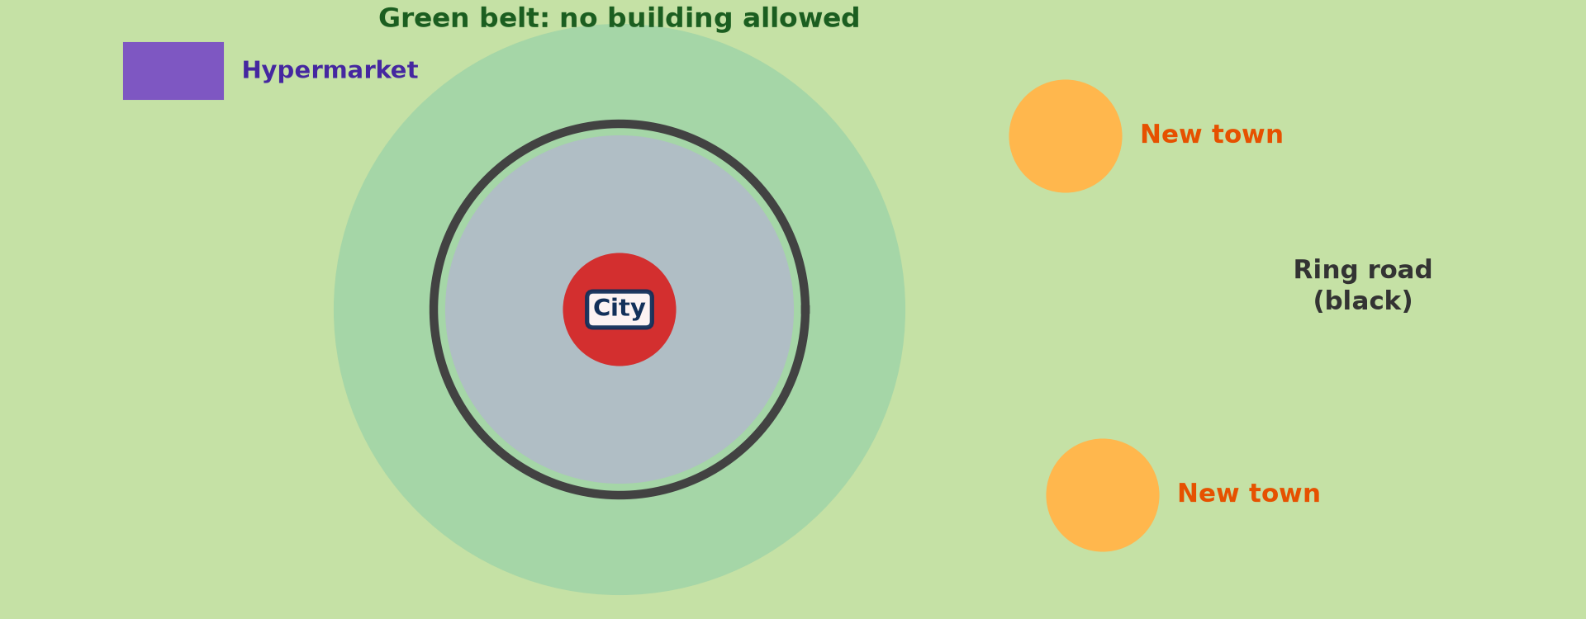
3. CHALLENGES: SOLUTIONS
Activity 5
Measures to control town spread.
Notes:
Activity 5. Look carefully at this diagram: measures to control town spread. Observe every detail before I ask the question.

Slide 31
3. CHALLENGES: SOLUTIONS
Activity 5: Question
How can planners protect the fringe?
Notes:
Here is the question for Activity 5: How can planners protect the fringe? Take one minute to think and write your answer in your rough notebook.

Slide 32
3. CHALLENGES: SOLUTIONS
Activity 5: Answer
Land-use plans, green belts and services before building.
Notes:
Let us check the answer together. Land-use plans, green belts and services before building.

Slide 33
BOARD SUMMARY
Board Summary
Topic: Rural Settlement
Sub-topic: Recent Changes in Rural Settlements
Lesson 8: The Urban Fringe
Notes:
Now we are going to copy the board summary. Write the title and the headings neatly in your notebooks. I will give you enough time for each slide, so do not rush.

Slide 34
BOARD SUMMARY
1. Meaning of the Urban Fringe
The urban fringe can be understood as follows:
Urban (rural–urban) fringe: It is the zone at the edge of a town where urban and rural land uses mix. It is a zone of transition and rapid change.
Notes:
Let us copy Meaning of the Urban Fringe. The urban fringe can be understood as follows. On this slide we have Urban (rural–urban) fringe. Write each point on a new line, with the key term first, and explain it in your own words when we revise.

Slide 35
BOARD SUMMARY
1. Meaning of the Urban Fringe
Illustration: location of the urban fringe
Notes:
Now draw this illustration in your notebook: location of the urban fringe. Give it a title and label it clearly.

Slide 36
BOARD SUMMARY
2. Characteristics
The urban fringe has the following characteristics:
Mixed land use: New housing estates, factories, dumps, cemeteries and airports mix with farms. Large land users move there because land is cheap.
Notes:
Let us copy Characteristics. The urban fringe has the following characteristics. On this slide we have Mixed land use. Write each point on a new line, with the key term first, and explain it in your own words when we revise. When you finish, we go to the next slide.

Slide 37
BOARD SUMMARY
2. Characteristics (continued)
Market gardening and commuting: Farmers grow vegetables and keep poultry for the town market. Many residents commute to work in the town.
Notes:
We continue with Characteristics. On this slide we have Market gardening and commuting. Write each point on a new line, with the key term first, and explain it in your own words when we revise.

Slide 38
BOARD SUMMARY
3. Challenges
The urban fringe faces the following challenges:
Problems: Farmland is lost to building, land prices rise and illegal settlements grow. Pollution, poor services and land disputes are common.
Notes:
Let us copy Challenges. The urban fringe faces the following challenges. On this slide we have Problems. Write each point on a new line, with the key term first, and explain it in your own words when we revise. When you finish, we go to the next slide.

Slide 39
BOARD SUMMARY
3. Challenges (continued)
Solutions: Planners create green belts, land-use zoning and planned estates. Services should be extended before settlement.
Notes:
We continue with Challenges. On this slide we have Solutions. Write each point on a new line, with the key term first, and explain it in your own words when we revise.

Slide 40
BOARD SUMMARY
3. Challenges
Illustration: controlling the fringe
Notes:
Now draw this illustration in your notebook: controlling the fringe. Give it a title and label it clearly.

Slide 41
FORMATIVE EVALUATION
Evaluation 1
Define the rural-urban fringe.
Notes:
Now let us check what you have understood. Question 1: Define the rural-urban fringe. Answer in your exercise book.

Slide 42
FORMATIVE EVALUATION
Expected Answer
The zone where the town meets the countryside.
Notes:
The expected answer is: the zone where the town meets the countryside. If you got it right, well done.

Slide 43
FORMATIVE EVALUATION
Evaluation 2
Give two challenges of the fringe.
Notes:
Now let us check what you have understood. Question 2: Give two challenges of the fringe. Answer in your exercise book.

Slide 44
FORMATIVE EVALUATION
Expected Answer
Loss of farmland and land conflicts (also lack of services).
Notes:
The expected answer is: loss of farmland and land conflicts (also lack of services). If you got it right, well done.

Slide 45
REMEDIATION
Remediation
Fill in the blanks:
The edge of a town is the rural-urban ______.
Uncontrolled town spread is urban ______.
Farming on town edges is ______ agriculture.
Notes:
For those who need more practice, fill in the blanks in your exercise book. The answers are: number 1, fringe; number 2, sprawl; number 3, peri-urban.

Slide 46
HOMEWORK
Homework
Visit the edge of your town and list the land uses you see.
Notes:
For your homework: Visit the edge of your town and list the land uses you see. We shall correct it at the beginning of our next lesson.

Slide 47
NEXT LESSON
Next Lesson
Our next lesson will be on:
Lesson 9: Differences between Rural and Urban Settlements
Notes:
Our next lesson will be on Lesson 9: Differences between Rural and Urban Settlements. Thank you for your attention, and see you next time.

Slide 48
BILINGUAL GAME
Bilingual Game (Jeu Bilingue)
English | Français
Fringe | La frange périurbaine
Sprawl | L'étalement urbain
Estate | Le lotissement
Quarry | La carrière
Dump | La décharge
Conflict | Le conflit
Notes:
Let us play the bilingual game. I say a word in English, and you give me the French word. Then we do the reverse.

Slide 49
LOGBOOK
Official Logbook (1/2)
Module / Topic | Rural Settlement
Lesson Title | Lesson 8: The Urban Fringe
Expected Learning Outcomes | Define the rural-urban fringe. Describe its characteristics. Explain its challenges and solutions.
Competence | Learners are able to describe the urban fringe and explain its challenges.
Notes:
I record this information in the official logbook of the class after the lesson.

Slide 50
LOGBOOK
Official Logbook (2/2)
Matter Taught | Meaning of the Urban Fringe; Characteristics; Challenges.
Evaluation | Formative evaluation and remediation exercise.
Homework | Visit the edge of your town and list the land uses you see.
Enrolment / Present / Absent | ____ / ____ / ____
Achievement | To be completed after the lesson.
Notes:
I complete the second page of the logbook: the matter taught, the evaluation, the homework and the attendance.

Slide 51
TEACHER'S NOTE
Teacher's Note
Timing: Homework correction, plan, objectives 8 min | Recall, situation, action 10 min | 5 activities 30 min | Board summary (copying) 30 min | Evaluation, remediation 10 min | Homework, next lesson 5 min | Logbook 7 min
Without the projector (Activity 1): draw the zones.
Without the projector (Activity 2): list land uses on your town's edge.
Without the projector (Activity 3): mention market gardens.
Without the projector (Activity 4): discuss land disputes.
Without the projector (Activity 5): discuss planning.
Notes:
This slide is for me, the teacher: it gives the timing of the lesson and what to do if the projector is not available.

Slide 52
REFERENCES
References
National Geography Syllabus, MINESEC/IGE/IP-SS, 2019 — Module 5 (Settlement Geography).
Photo, Activity 2: “Chicago suburbs from the air” by Scorpions and Centaurs, CC BY-NC-SA 2.0, via Flickr (https://www.flickr.com/photos/62736719@N00/2912708983)
Photo, Activity 3: “Sandga Market in Douala, Cameroon” by The Advocacy Project, CC BY-NC-SA 2.0, via Flickr (https://www.flickr.com/photos/42487558@N00/3636438732)
Photo, Activity 4: “Cementing Ethiopia's progress” by DFID - UK Department for International Development, CC BY 2.0, via Flickr (https://www.flickr.com/photos/14214150@N02/8757865770)
Diagrams and animations: drawn for this lesson (Geography Department).
Notes:
These are the references and picture credits used to prepare this lesson.

